Slide 1

Model validation
ASP.NET CORE MVC

Slide 2
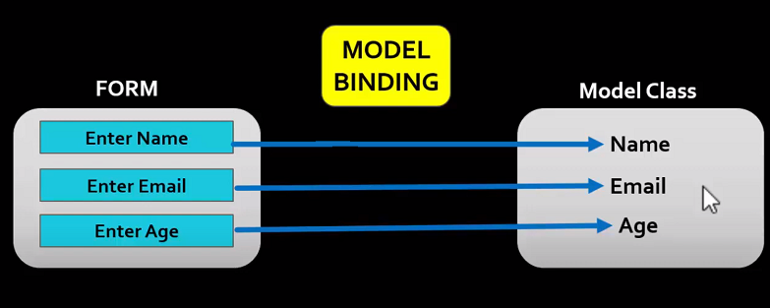
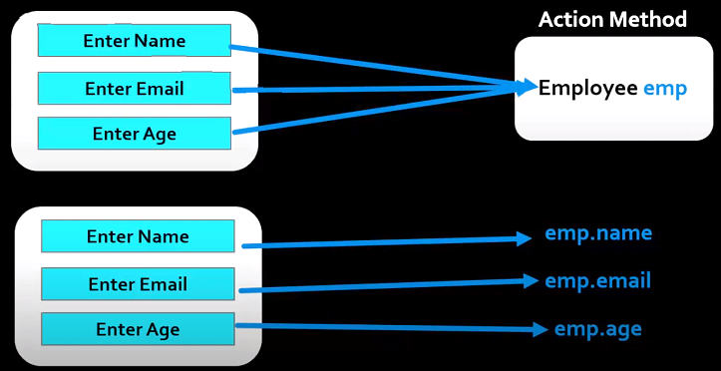
MODEL VALIDATION
Often the data entered by the user is not valid and cannot be saved into the database.
The entered data may contain a type or user may intentionally enter the inappropriate data.
Hence, we need to validate the user input before storing it in the database.

Slide 3
MODEL VALIDATION
The ASP.NET Core gives us Model Validator, which uses the validation attributes to validate the model, which makes our task easier.
We also take a look at ModelState and how to use it. Finally, we look at the list of validation attributes.
The Form Data is posted to Controller action is automatically mapped to the action parameter by the Model Binder. We already looked at how Model Binding works in ASP.NET Core.
The Model needs to be validated for the correctness.
These validations can be done at the client side before sending data to the server or at the server side when the data is received from the client.

Slide 4
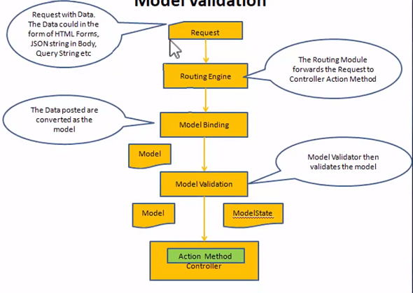
MODEL VALIDATION

Slide 5
MODEL VALIDATION
All these validation attributes are located in
[Required]
[StringLength]
[EmailAddress]
[Range]
[RegularExpression]
[Compare]
[Phone]
[Url]
Validates that the field is not null.
Validates that a string property value doesn’t exceed specified length limit.
Validates that the property has an email format
BUILT IN ATTRIBUTES
Validates that the property for min. and max. range
Validates that the property value matches a specified regular expression.
Validates that two property in a model match.
Validates that the property has a Phone pattern.
Validates that the property has a URL format.

